Slide 1


BOOTCAMP TRAINING – IDA
WEEK 5 REPORT
- Eeshita Deepta

Slide 2
Day 1 – Azure Synapse Analytics
Followings were the learning of Days- 1:
SQL Data Warehouse
Azure Synapse Mapping Data Flow
Pipeline
Data Ingestion and Preparation
Using SQL to analyze data

Slide 3
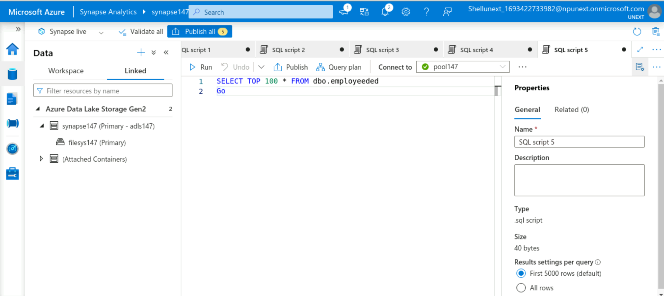

Slide 4
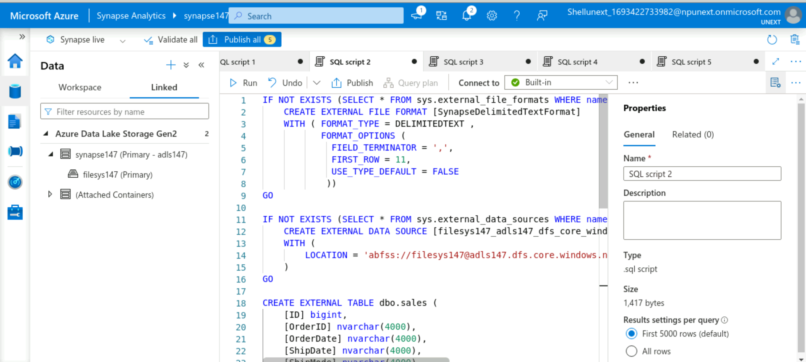

Slide 5
Day – 2 Power BI
Followings were the learning of Day-2:
Exploring Power BI and its interface
Data Source Connection (CSV, Excel)
Data Loading and Transformation
Eliminating duplicates
Slicers
Handling dates

Slide 6
Day 3 – Power BI
Followings were the learning of Day-3:
Removing duplicate values
Removing errors
DAX & Calculated Columns
Measures
Aggregation functions
Reports and Dashboards in Power BI

Slide 7
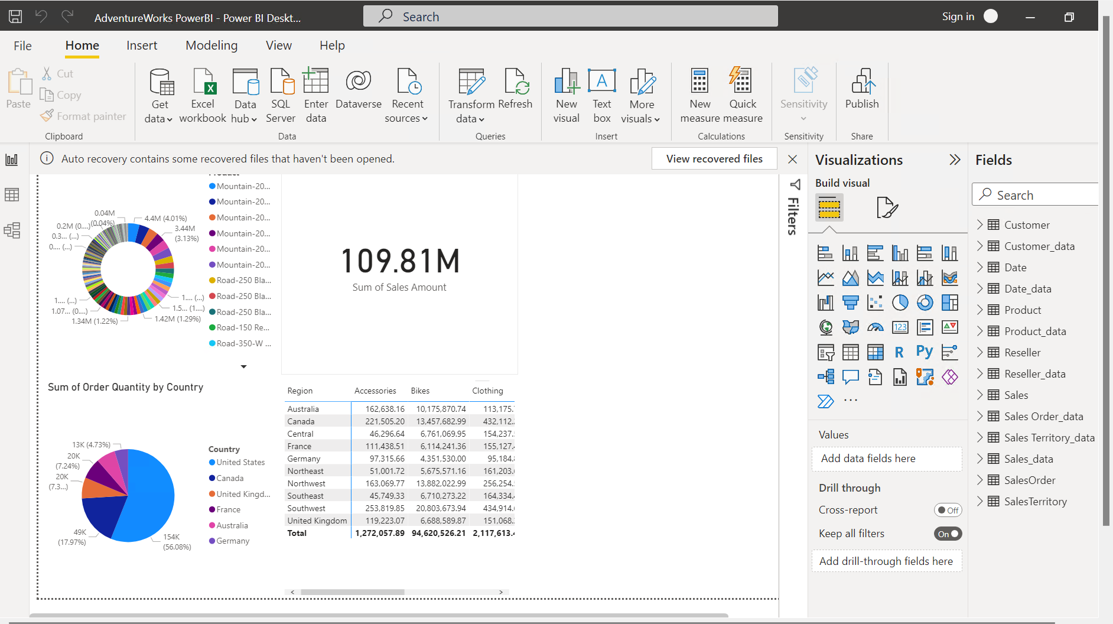

Slide 8
Day – 4 Python
Followings were the learning of Day-4:
Data types in Python
Boolean values
Arithmetic Operators
Logical Operators
Hands-on assessment
Zip() function
Enumerate() function
Range() function

Slide 9
